Slide 1

Introduction to Data Science – CS 675. Final Project – Time Series Forecasting
Ali Inamdar

Slide 2
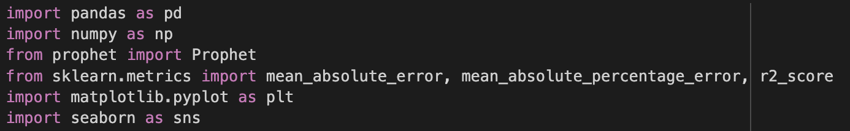
Importing all libraries:

Slide 3
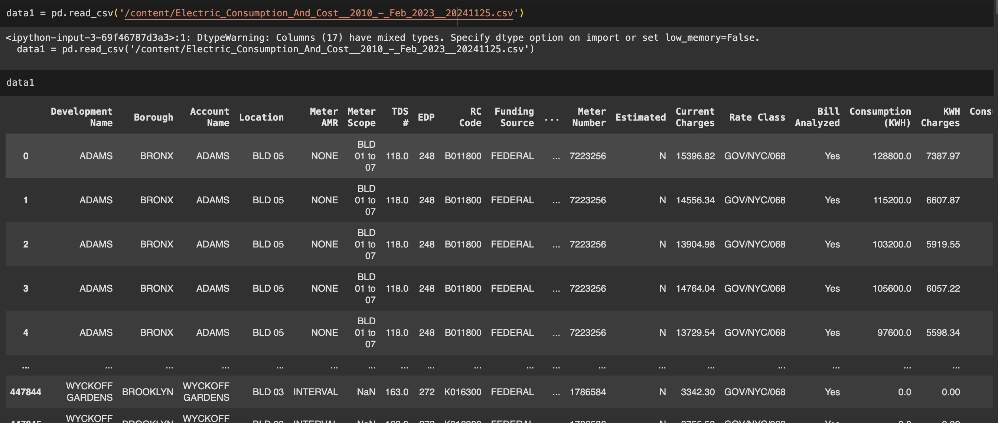
Importing the dataset and making a data frame:

Slide 4
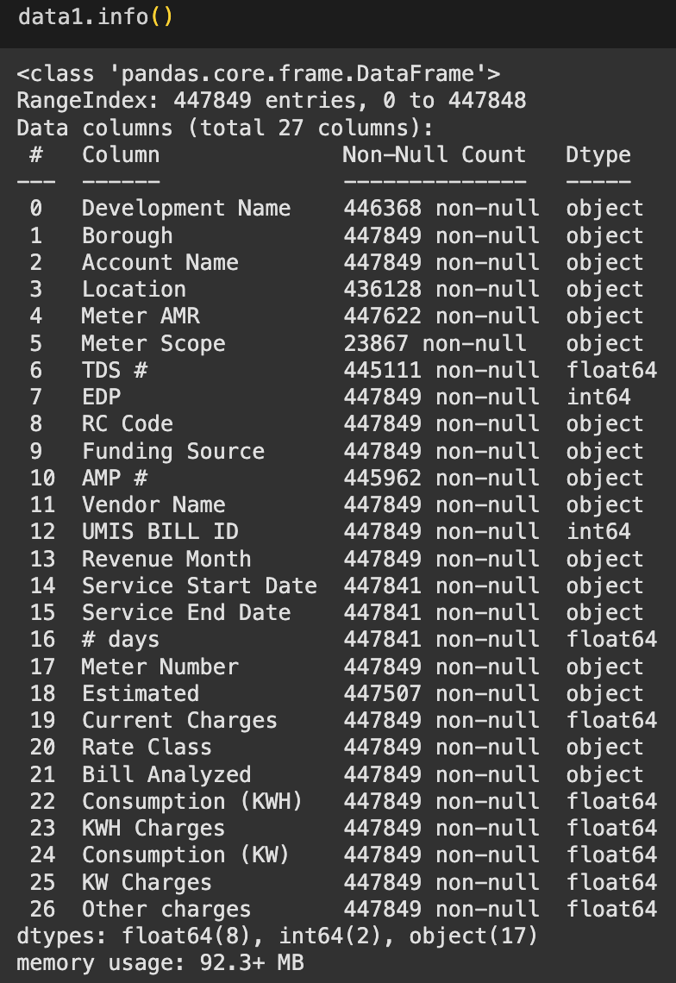
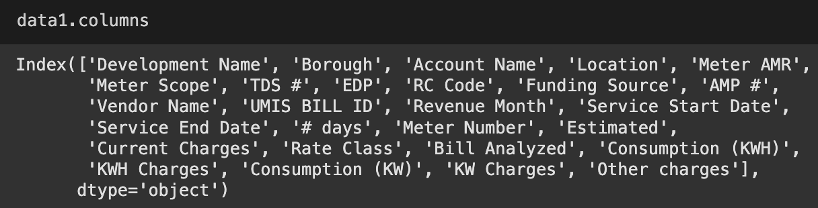
Information about the dataset:

Slide 5
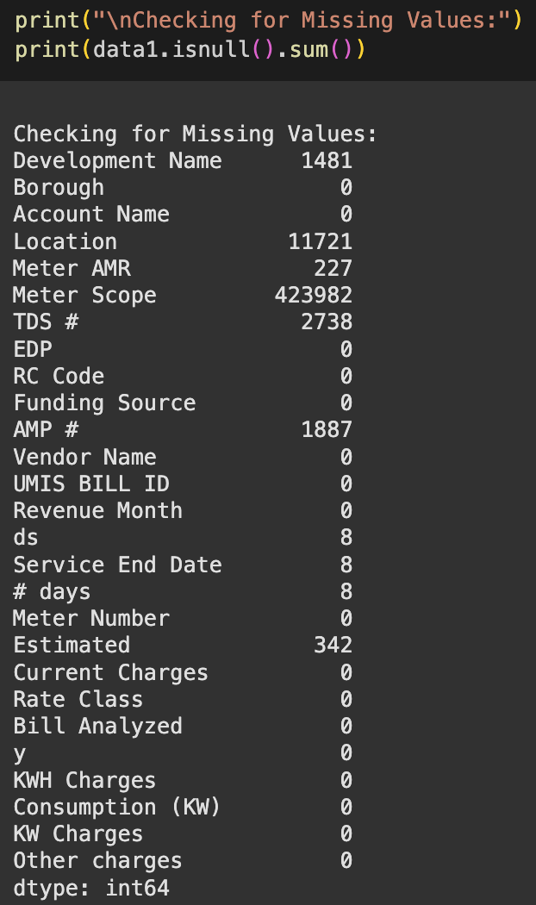
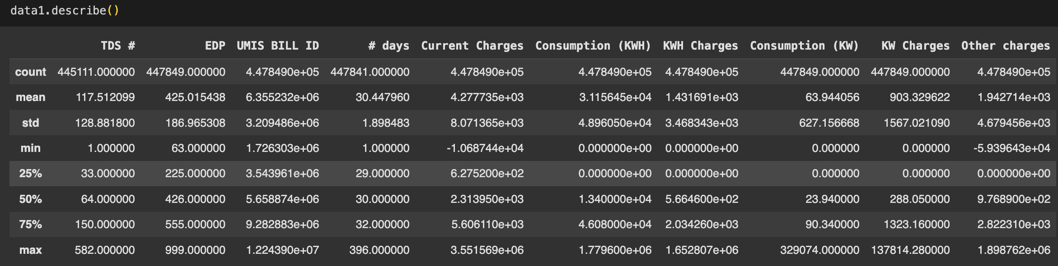
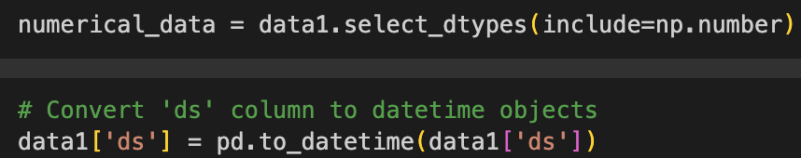

Slide 6
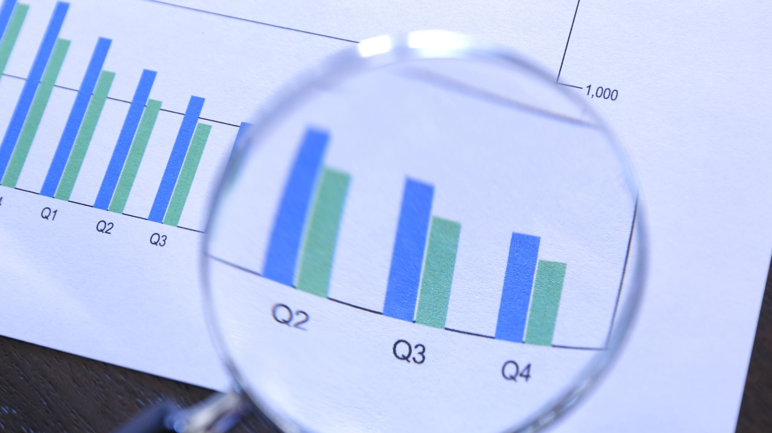
Exploratory Data Analysis:

Slide 7
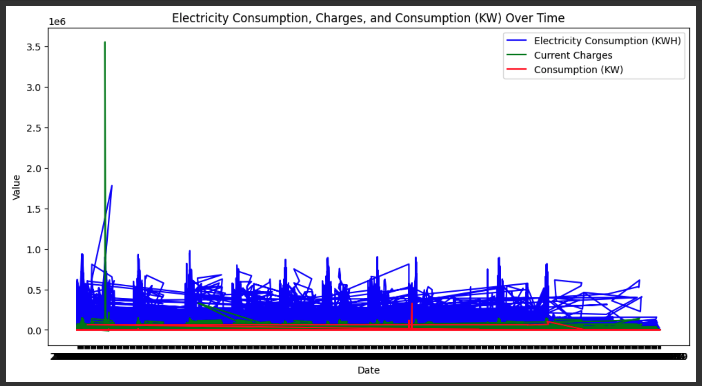
Energy Consumption Graph:

Slide 8
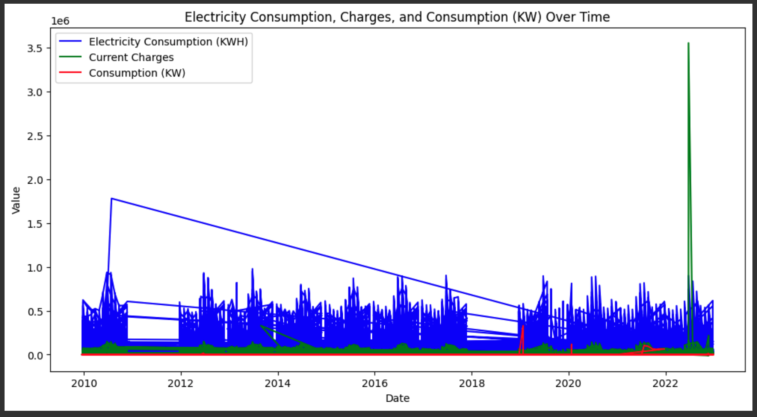

Slide 9
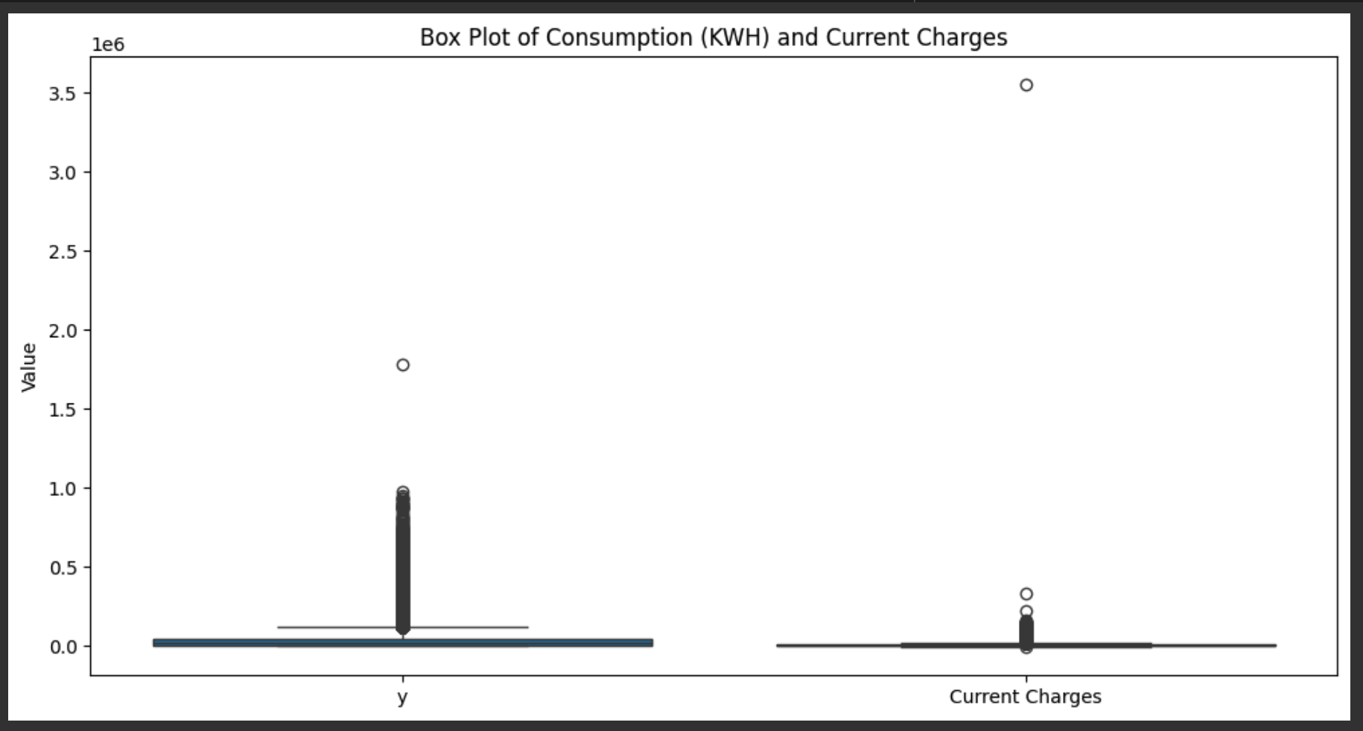

Slide 10
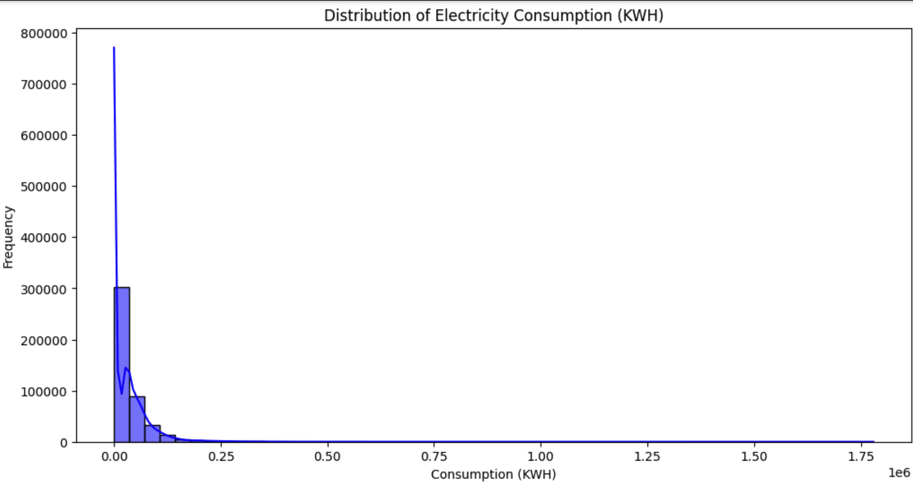
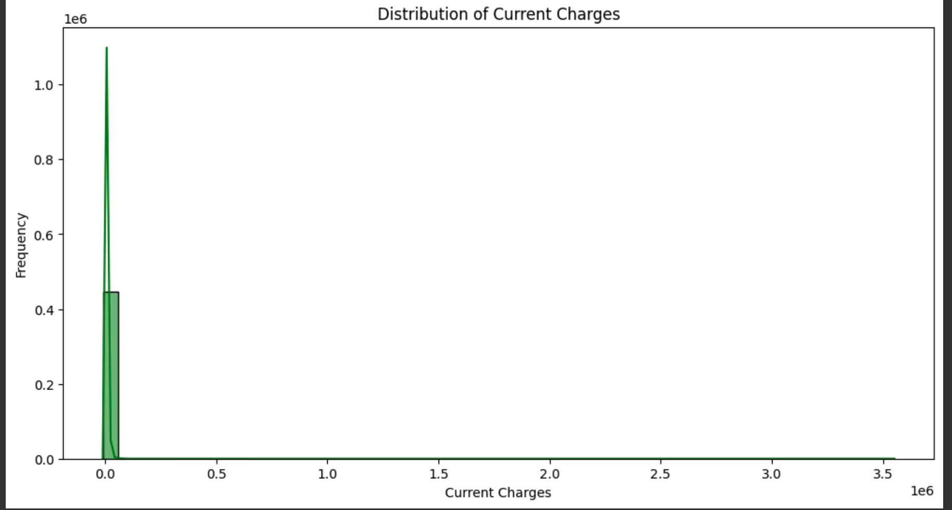

Slide 11
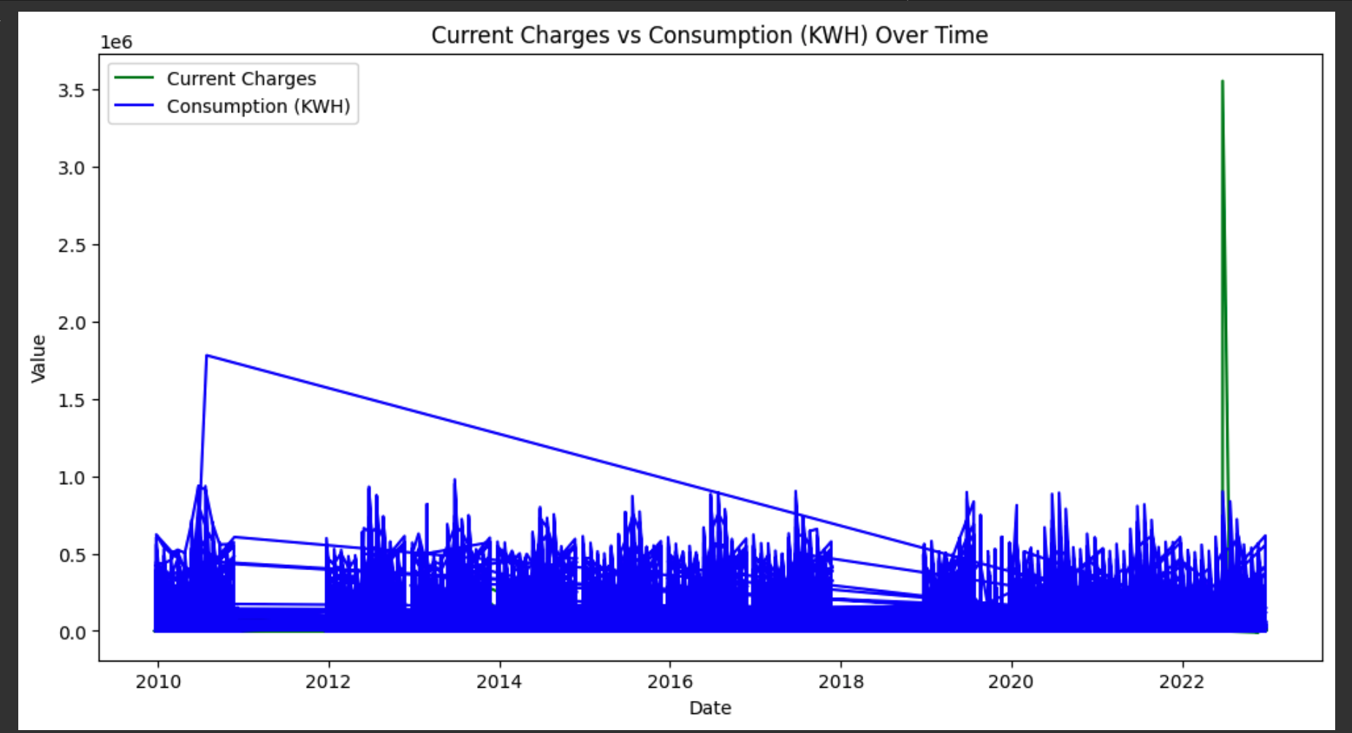

Slide 12
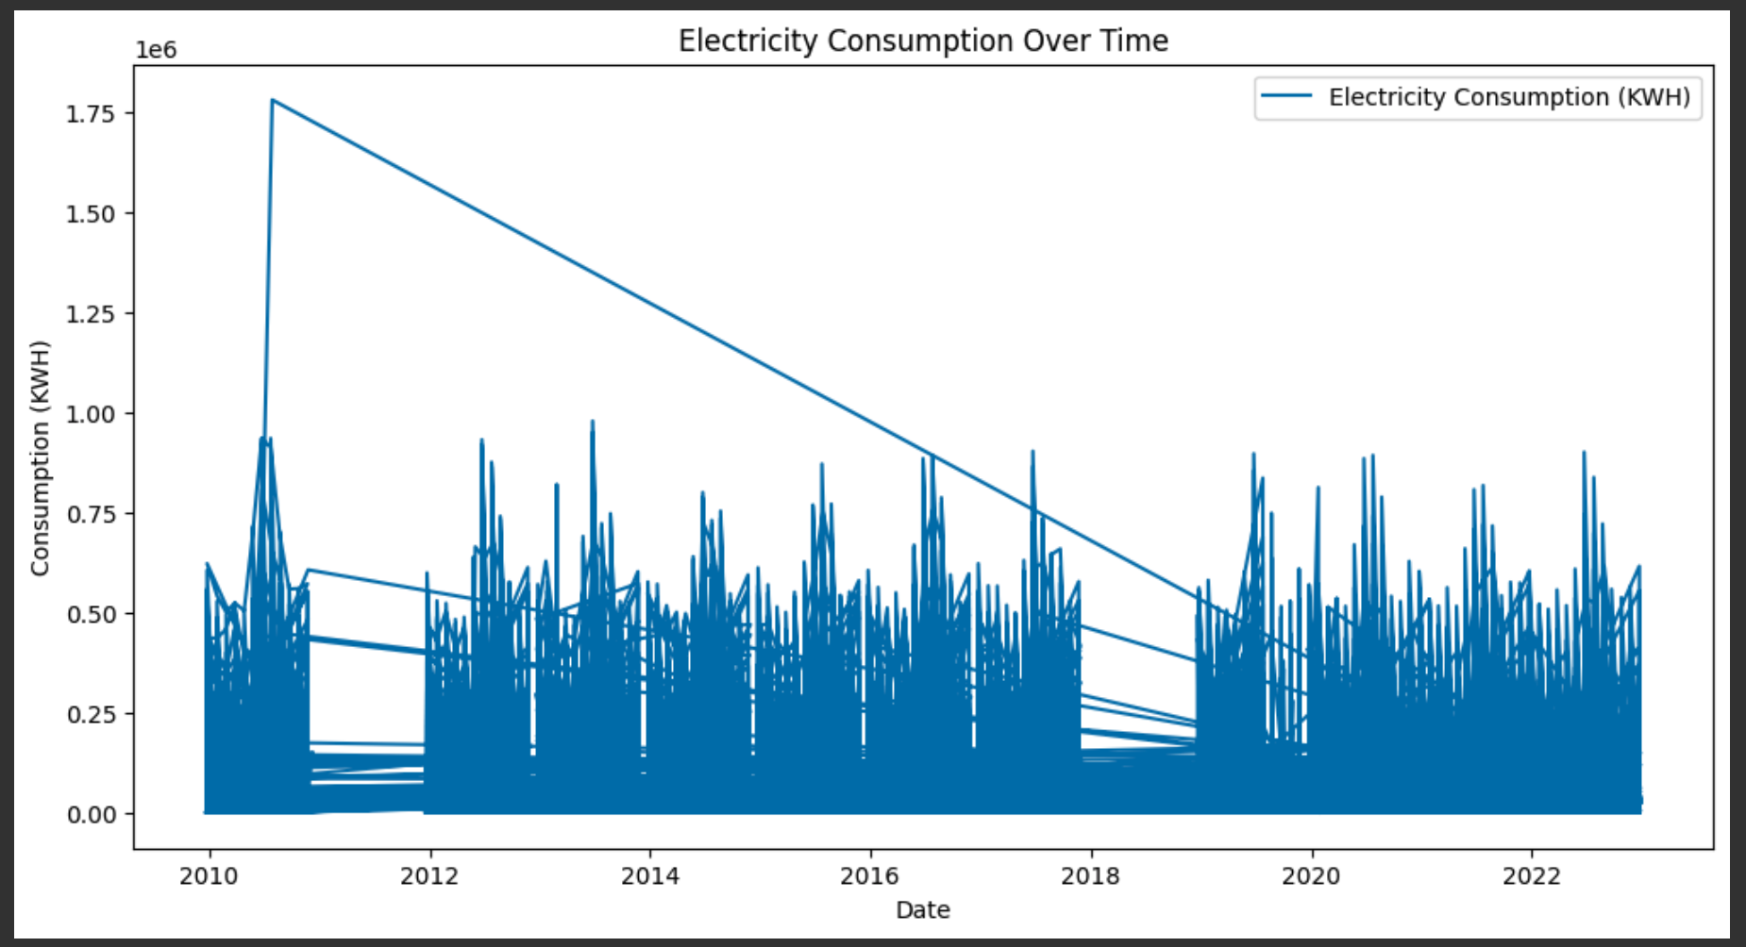
Total Energy Consumption in all 5 boroughs:

Slide 13
Implementing the FBProphet Model:

Slide 14
FBProphet Model:
The Facebook Prophet model is a forecasting tool developed by Facebook for predicting time series data, especially in cases where the data exhibits trends, seasonality, and holidays. It is designed to be intuitive, easy to use, and robust to missing data and outliers. Prophet decomposes the time series into three main components:
Trend: Captures the overall direction (upward, downward) of the data.
Seasonality: Accounts for repeating patterns at specific times (e.g., daily, weekly, yearly).
Holidays/Events: Allows for the incorporation of special events that could affect the data.
The model is particularly useful when you have large datasets with strong seasonal effects and irregular trends, and it can handle data with missing values or anomalies. It also provides uncertainty intervals for the forecast.

Slide 15
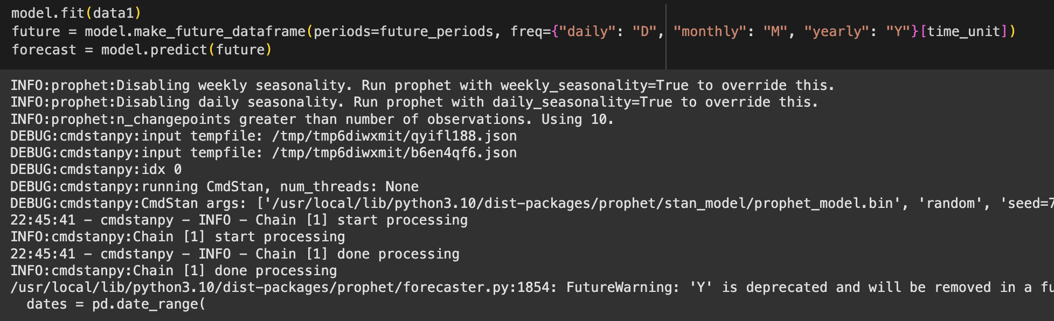
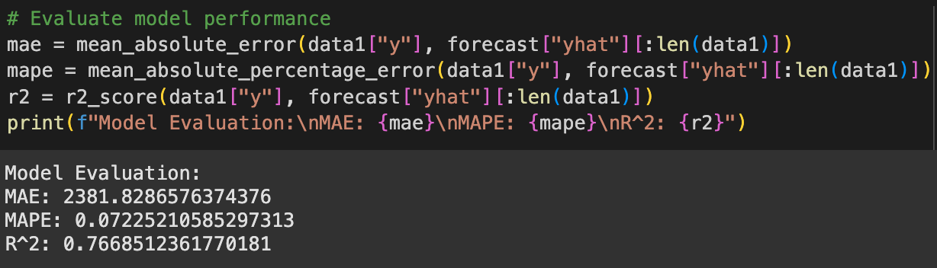

Slide 16
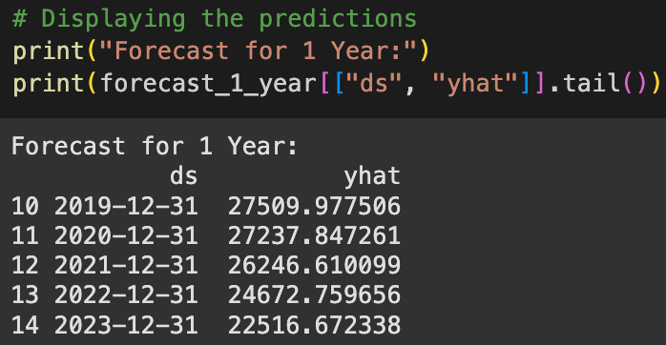
Forecasting the values for 1 year:

Slide 17
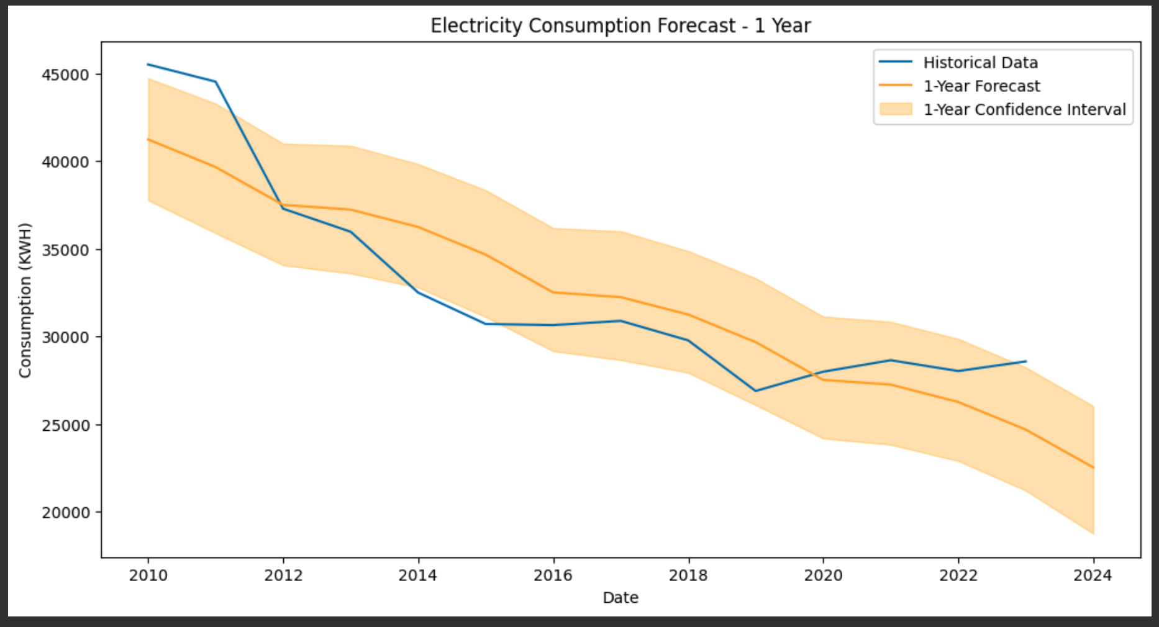

Slide 18
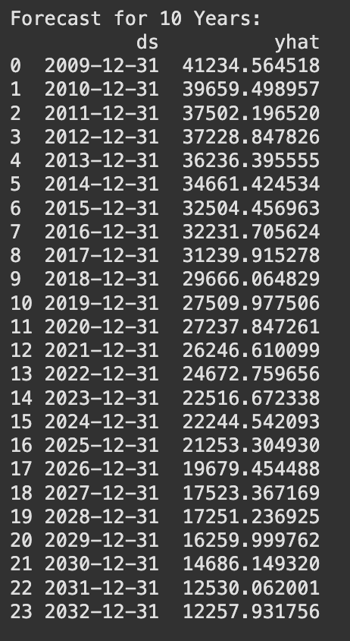
Forecasting the values for 10 years:

Slide 19
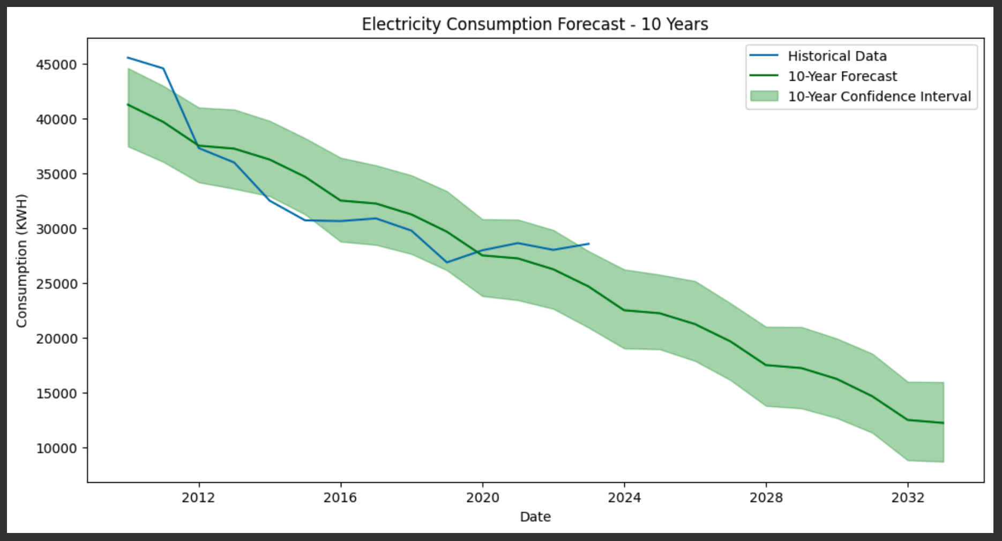

Slide 20
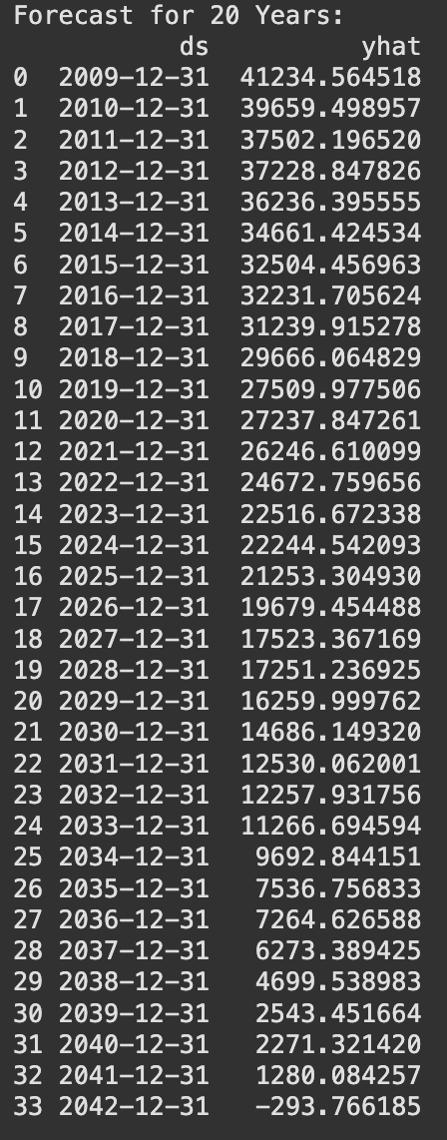
Forecasting the values for 20 years:

Slide 21
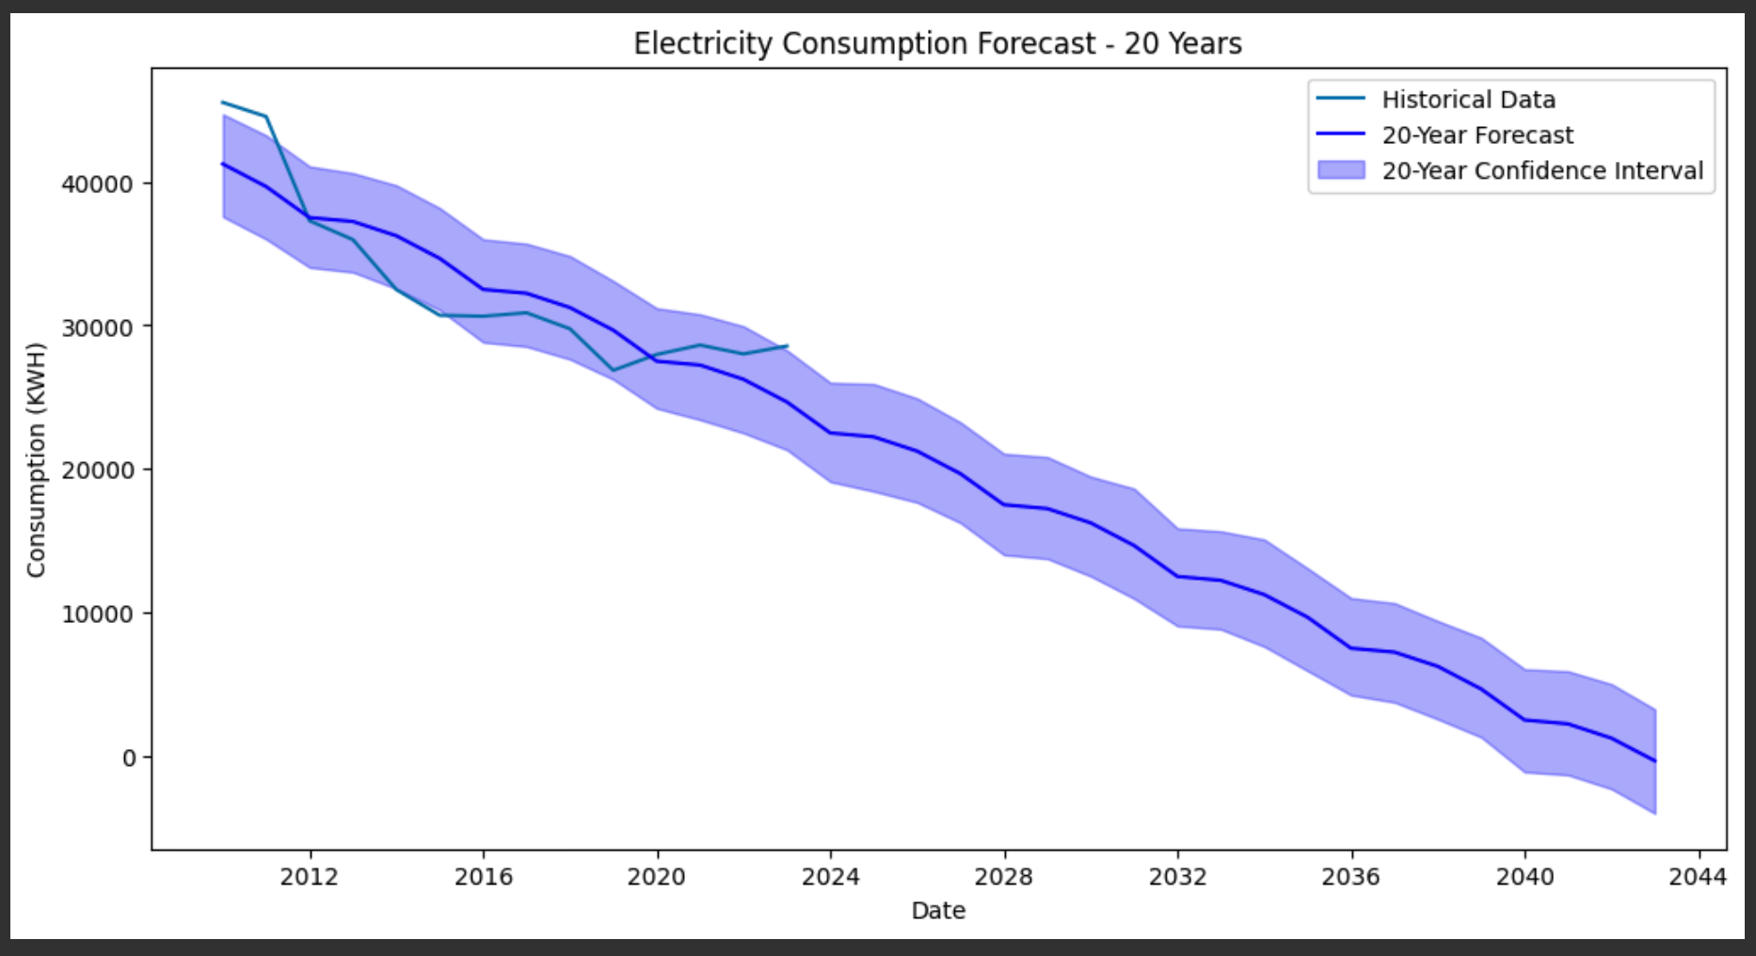

Slide 22
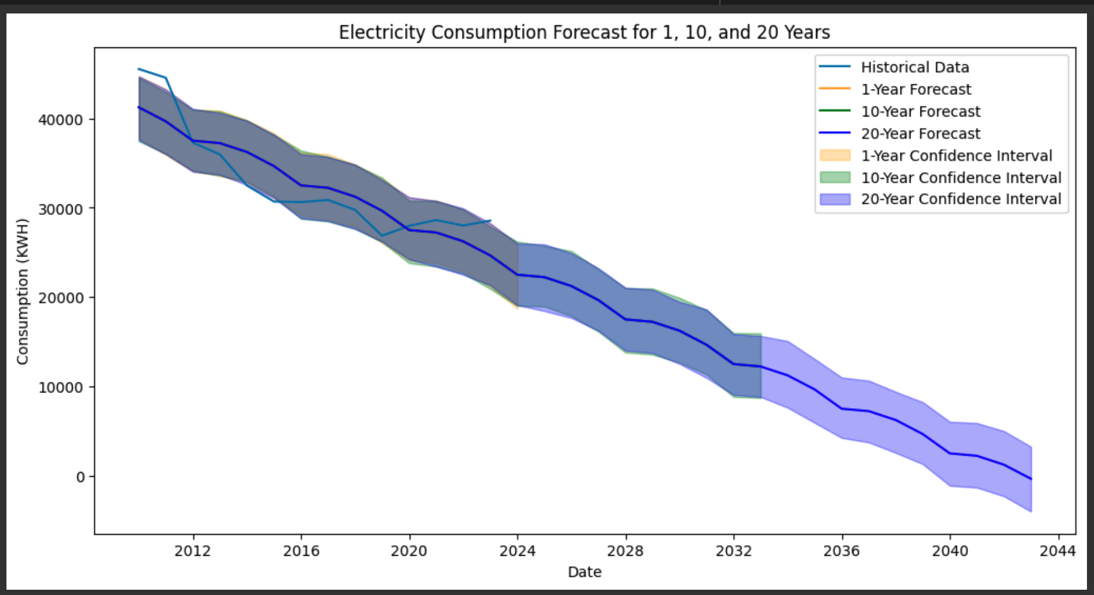
Overall Forecasting:

Slide 23
Extra Credit:
Forecasting the data for each borough individually:
Brooklyn
Bronx
Staten Island
Queens
Manhattan

Slide 24
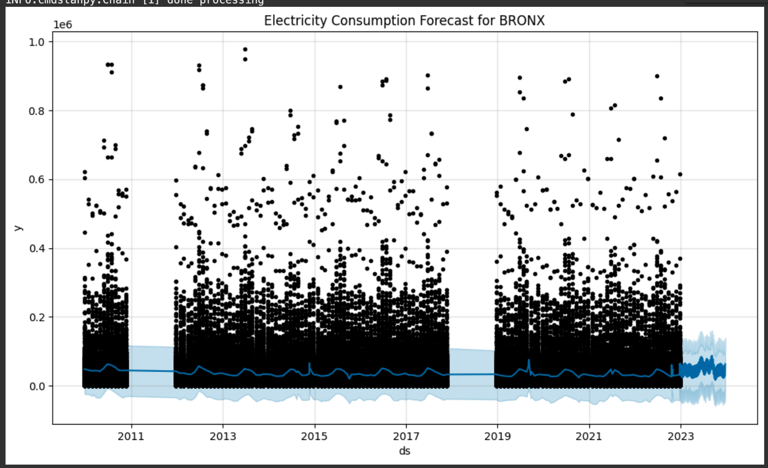
Bronx:

Slide 25
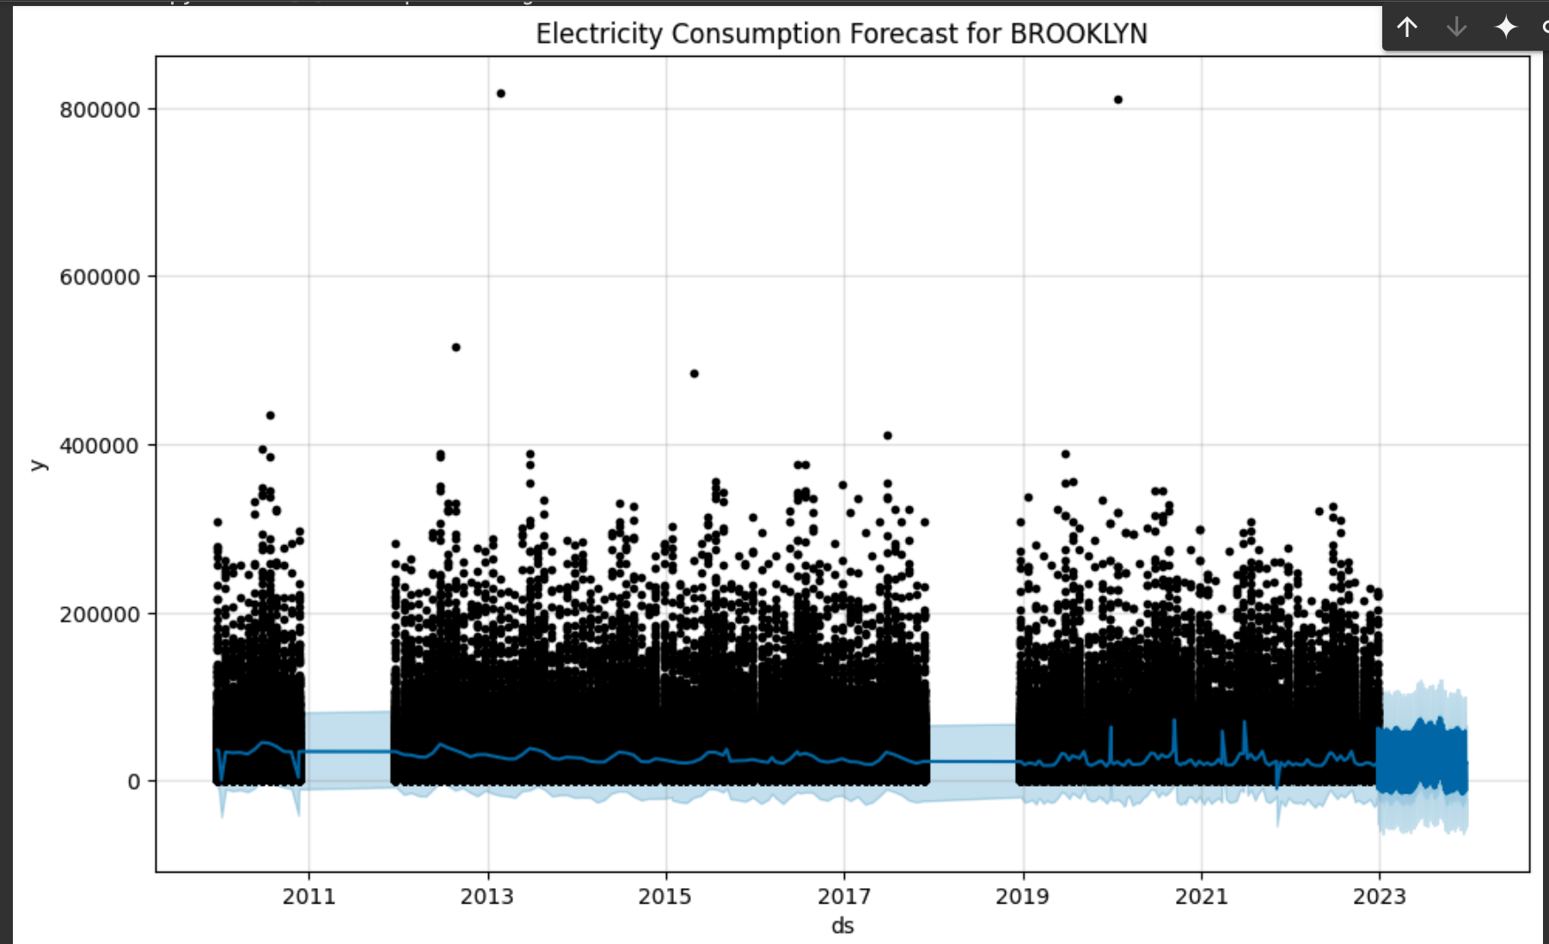
Brooklyn:

Slide 26
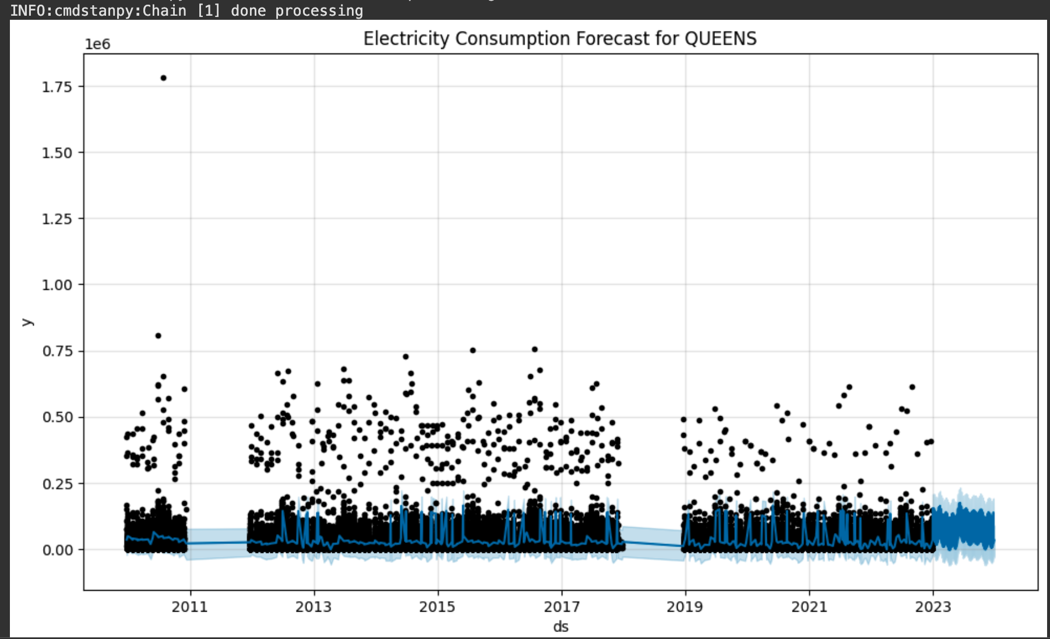
Queens:

Slide 27
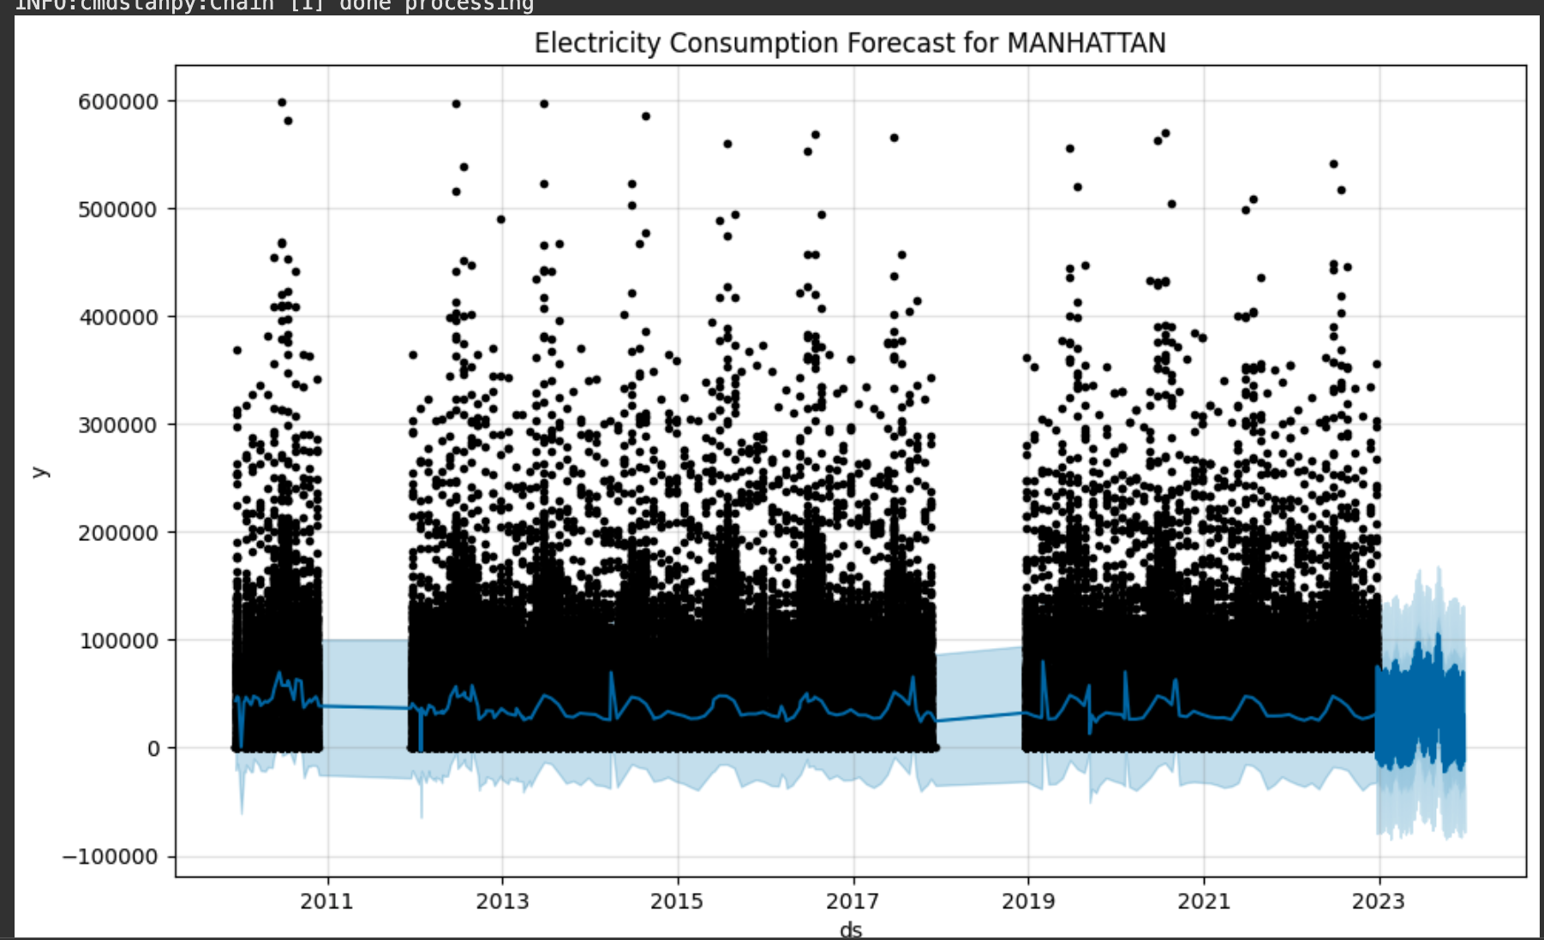
Manhattan:

Slide 28
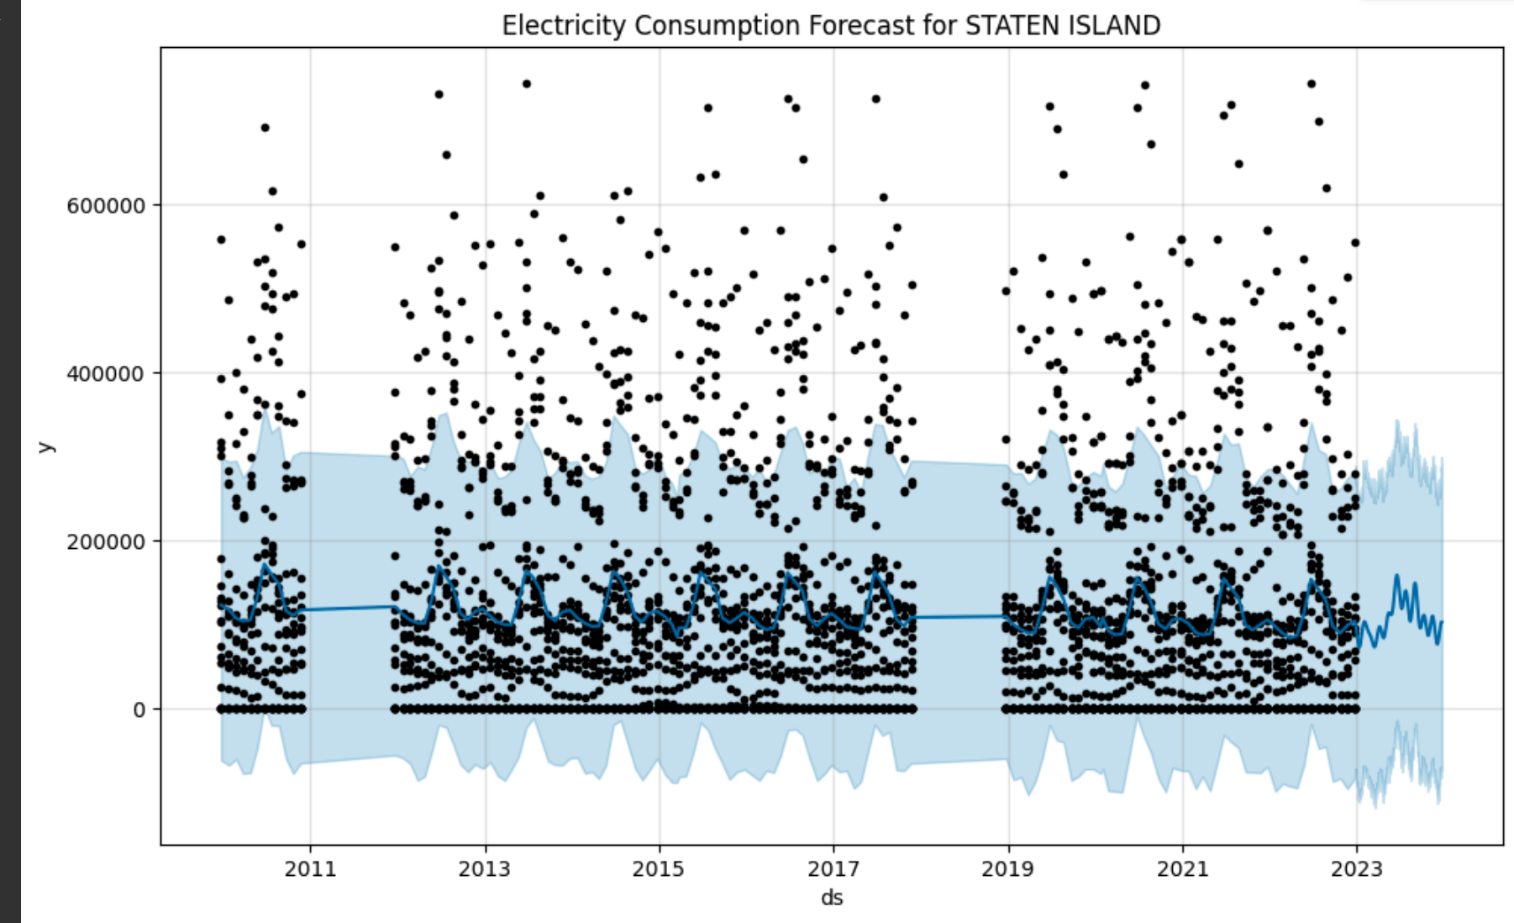
Staten Island:

Slide 29
Conclusion:
Here, we have made the the forecast for energy consumption in KWH for all 5 boroughs of New York, and based upon the findings we can conclude that even now and in future Manhattan is and will have the highest consumption of all the boroughs.

Slide 30
Future Recommendations:
We can use many clustering models to create different clusters based on different columns such as Boroughs , energy consumption and the billing amounts.
We can also use a geospatial dataset alongside this data and create which sector of any given borough is consuming more energy compared to others and be plotted on a real time map using the ‘keplergl’ model.

Slide 31

THANK YOU!

